Slide 1







Enterprise Blockchain Developers (Intermediate)
In support of
Powered By

Slide 2
Outline
Node js and Express js
© 2017-2020 SmartMesh Foundation Pte. Ltd. | MeshBox Foundation Pte. Ltd.

Slide 3
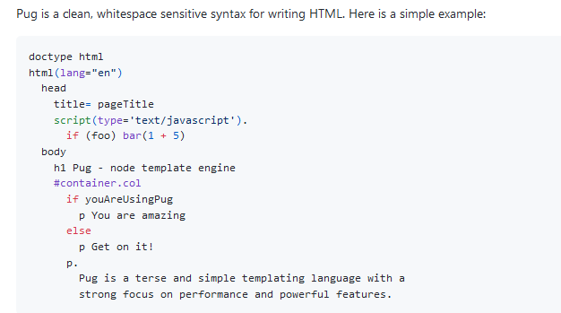
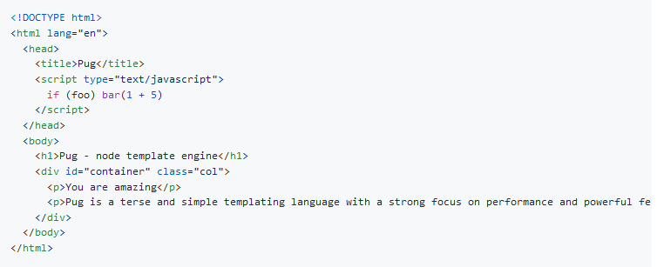
Views: Templates
Pug formly named Jade

Slide 4
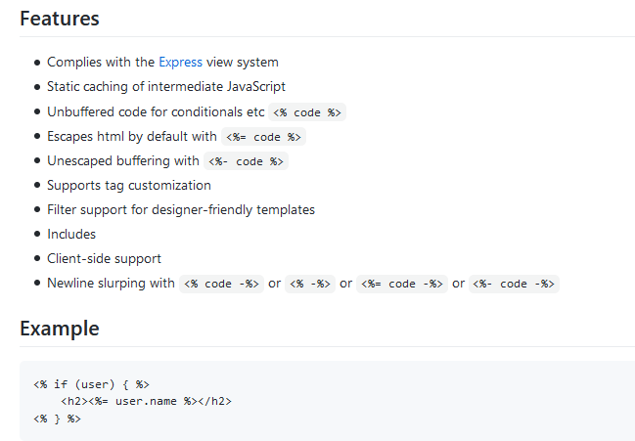
Views: Templates
EJS: html + code https://github.com/tj/ejs

Slide 5
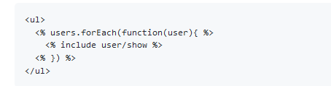
Views: Templates
EJS: includes
makeing html managable

Slide 6
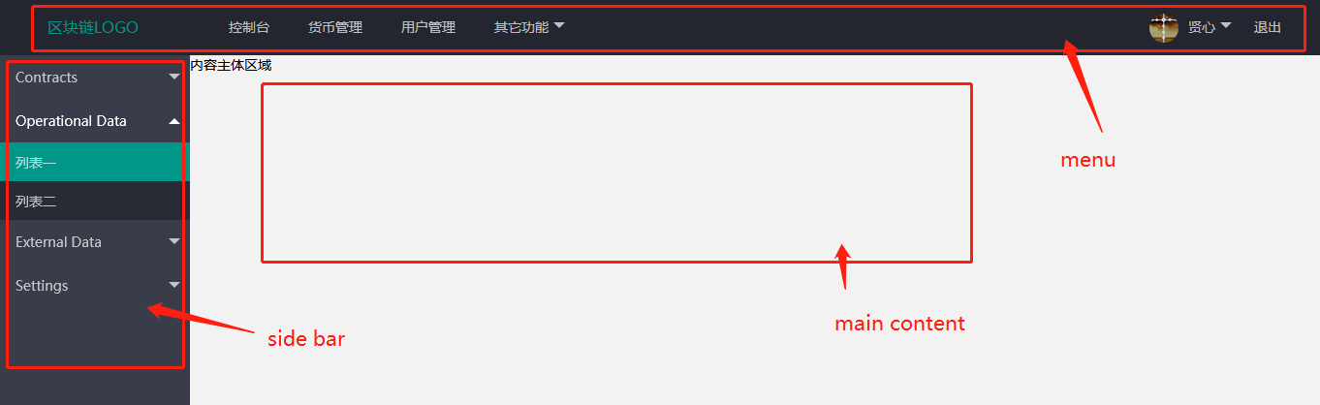
Views: Templates
How to design your templates?
1 draw a wireframe,
2 define the layout
3 write each part to a component

Slide 7
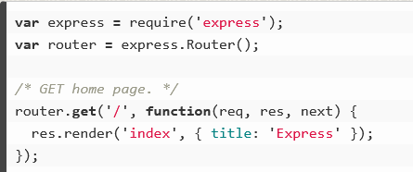
Views: Pass Parameters down to the View
Code Demo: pass params
Code Demo: check login logic

Slide 8
Views: Pass Parameters down to the View
render vs redirect

Slide 9
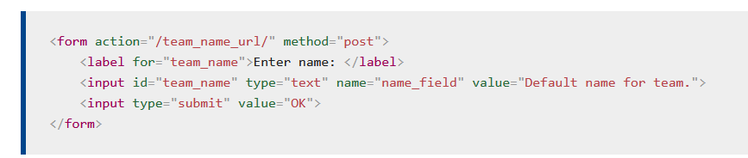
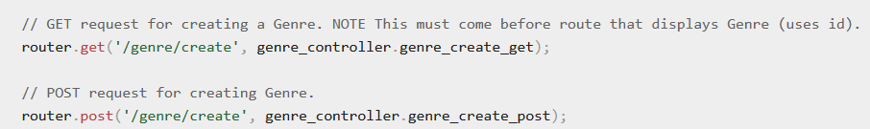
Form
1 specify Router
2 specify the request type, usually POST for Forms
Form will take inputs value as parameters to send to the server
action should match routes, then the route will call the controller function to handle the request. In this case, put action = /genre/create

Slide 10
Views: Code Demo
add views to node js apiCod

Slide 11
How to use JWT on client side
get the token from api
1. store it in cookie (demo this method)
2. store it in localstore
Difference
Local Storage
Pros: It's convenient.
Cons: It's vulnerable to XSS attacks.
Cookies
Pros: The cookie is not accessible via JavaScript; hence, it is not as vulnerable to XSS attacks as localStorage.
Cons: Depending on the use case, you might not be able to store your tokens in the cookies. For Instance: Cookies have a size limit of 4KB.

Slide 12
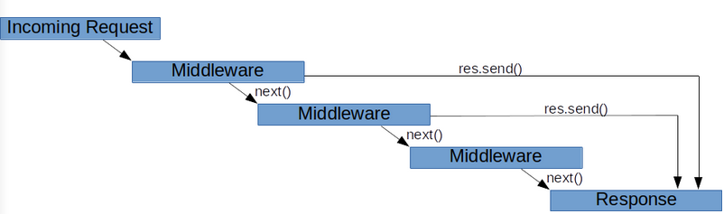
Middleware
demo auth middleware

Slide 13
API vs Non API Application
API doesn't have to pass the params to the view
view coud be written separately
view use js to parse the data
Compare it with a non api program
Data is proccessed in controller and passed down to the view
but view and program cannot be separated

Slide 14
File Upload
localhost (code demo)
https://www.geeksforgeeks.org/file-uploading-in-node-js/
ipfs (code demo)
https://docs.ipfs.io/install/ipfs-desktop/#windows
https://medium.com/better-programming/how-to-get-started-with-ipfs-and-node-fa04baec6b3a

Slide 15
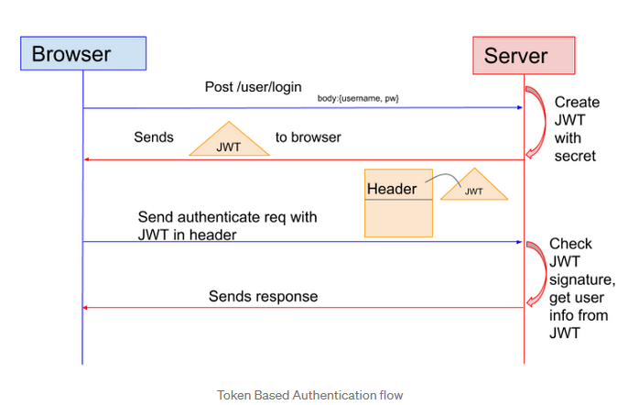
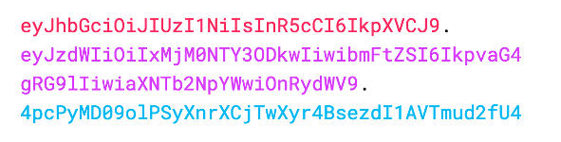
JsonWebToken(JWT)
What is JWT

Slide 16
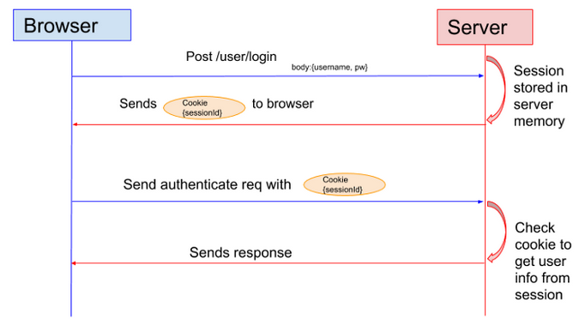
JsonWebToken(JWT)
JWT vs Session
Drawback: the Session cannot be verified cross servers for the cluster, unless stored in database

Slide 17
Send Parameters to the View
Code Demo
Compare a normal program with a api program

Slide 18
Form
1 specify Router
2 specify the request type, usually POST for Forms
Form will take inputs value as parameters to send to the server
action should match routes, then the route will call the controller function to handle the request. In this case, put action = /genre/create

Slide 19
File Upload
https://www.geeksforgeeks.org/file-uploading-in-node-js/

